Slide 1


A Self-Adaptive System
in Information Sharing Platform
Guanjie Wang Lucian Zhao
Team 12
Department of Elect. & Comp. Eng.

Slide 2
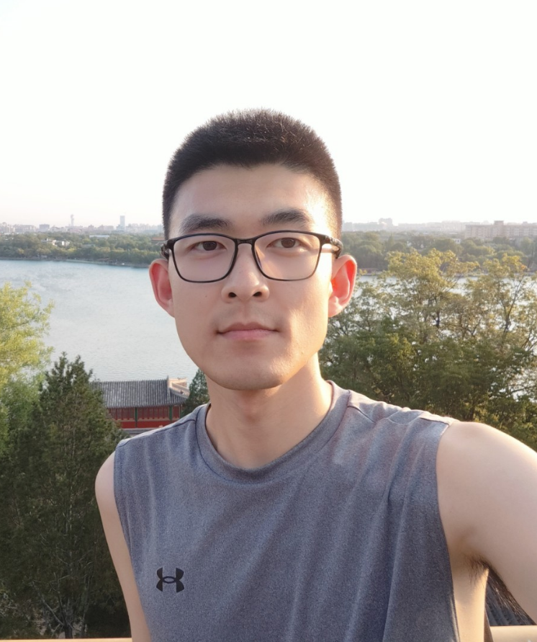
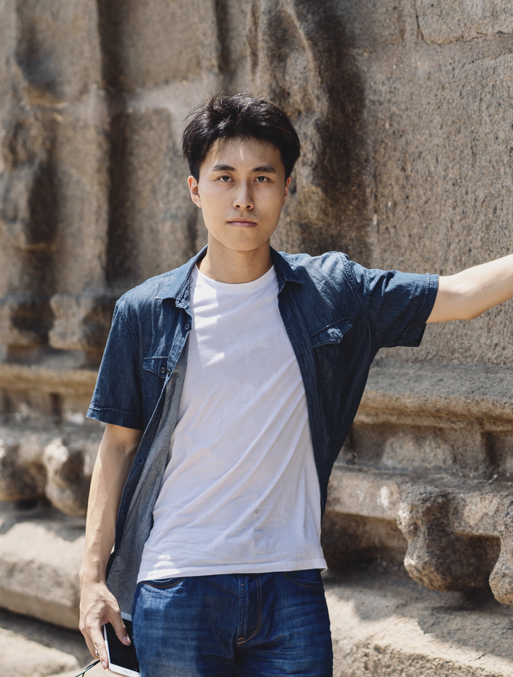
TEAM MEMBERS
Guanjie Wang, MEng ECE, Coop
Department of Electrical & Computer Engineering, University of Waterloo
Lucian Zhao, MEng ECE, Coop
Department of Electrical & Computer Engineering, University of Waterloo

Slide 3
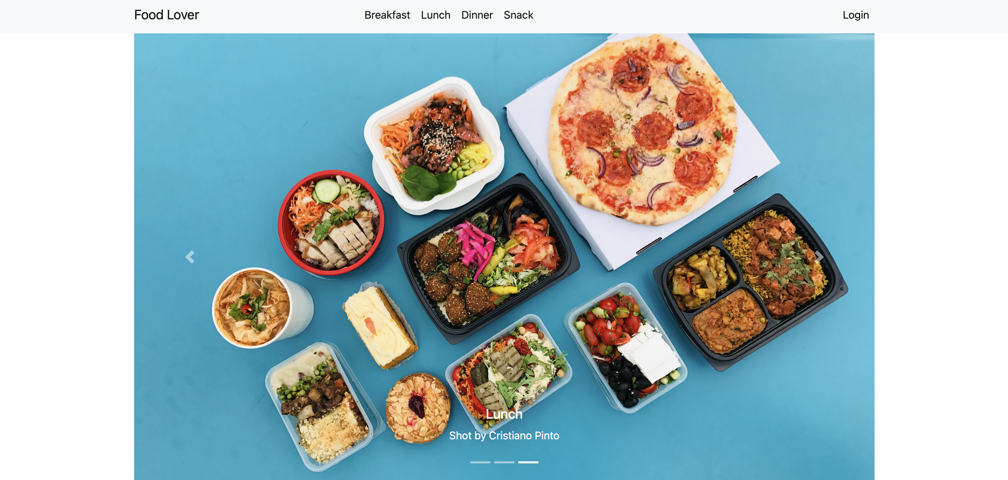
PROBLEM
Due to variations in the number of users, different time points, and network conditions, the server's load may also differ.
The main challenges currently facing the original food lover application include two aspects:
Load Expansion Issue
Extended Wait Times

Slide 4
Goal
Cost: Computing resources are minimized as much as possible
Total Error Rate: Must Less Than 5%
Throughput: Maximize throughput consistently across all periods

Slide 5
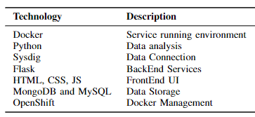
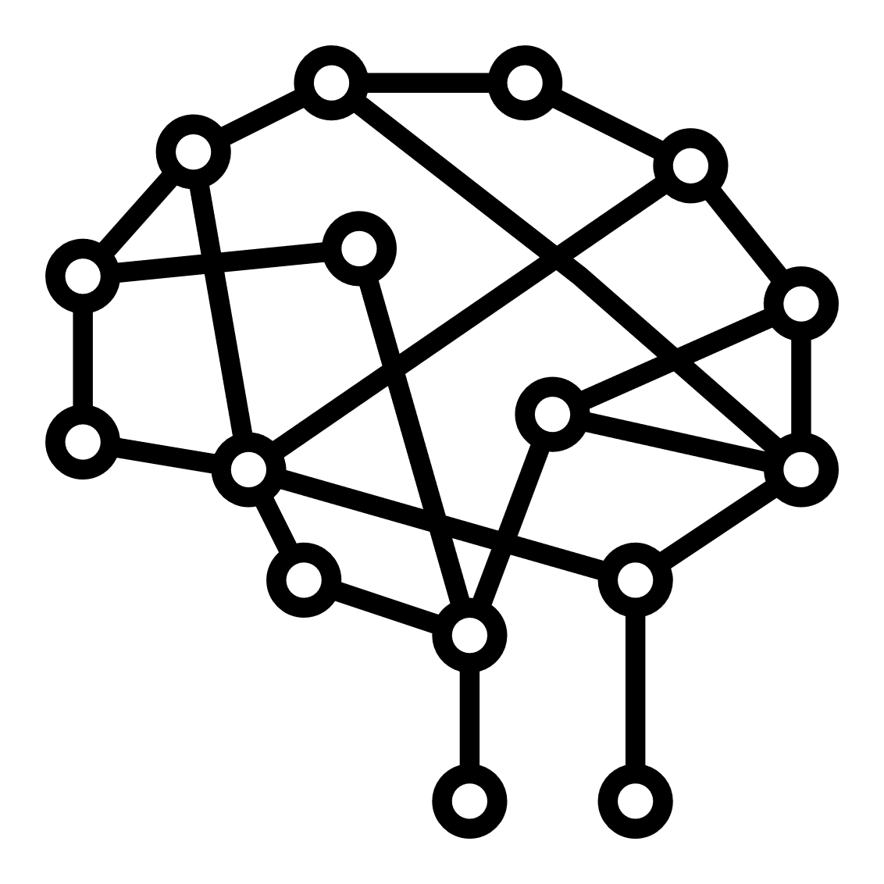

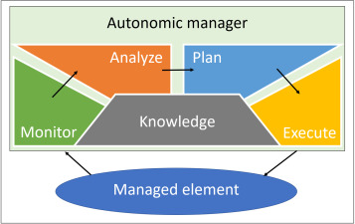

TECHNOLOGY
Long-Short Time Memory
Three-layer
MAPE-K
Statistical Analysis

Slide 6
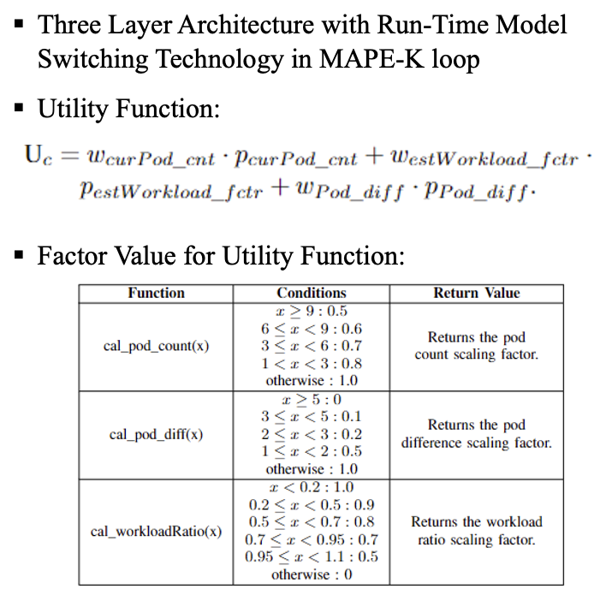
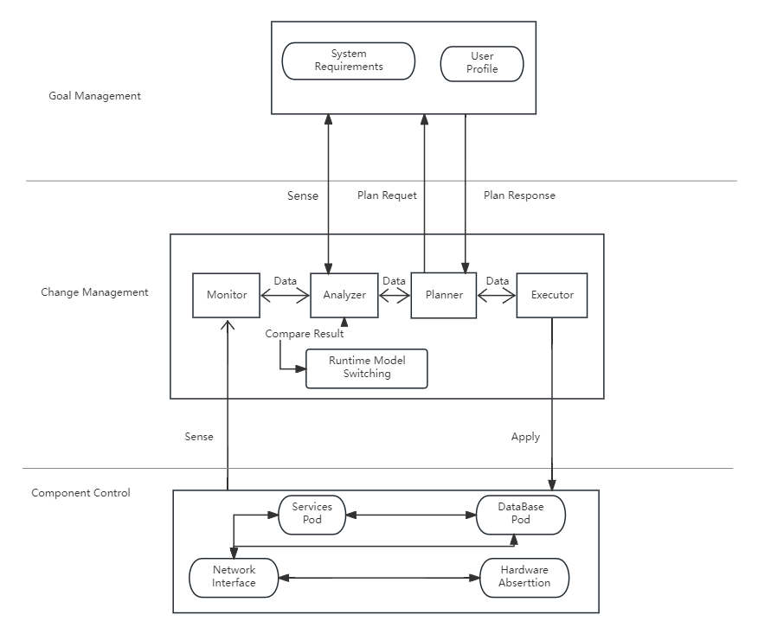
SOLUTION
3-layer Architecture
Methods

Slide 7
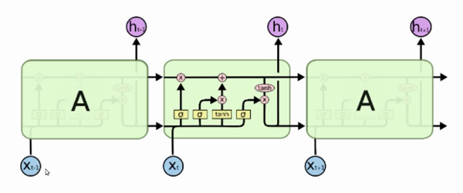

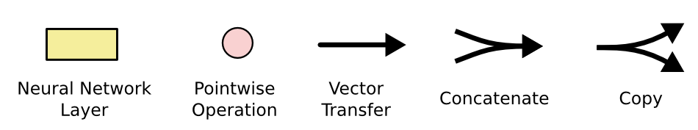
SOLUTION
DL Model
Long-Short Time Memory
Statistical Method
Exponentially Weighted Moving Average
More accurate: ~ 80%
Slow: >10s
Faster: < 100ms
No Long-term memory
Cannot predict expansion
❗️
Loss meets threshold

Slide 8
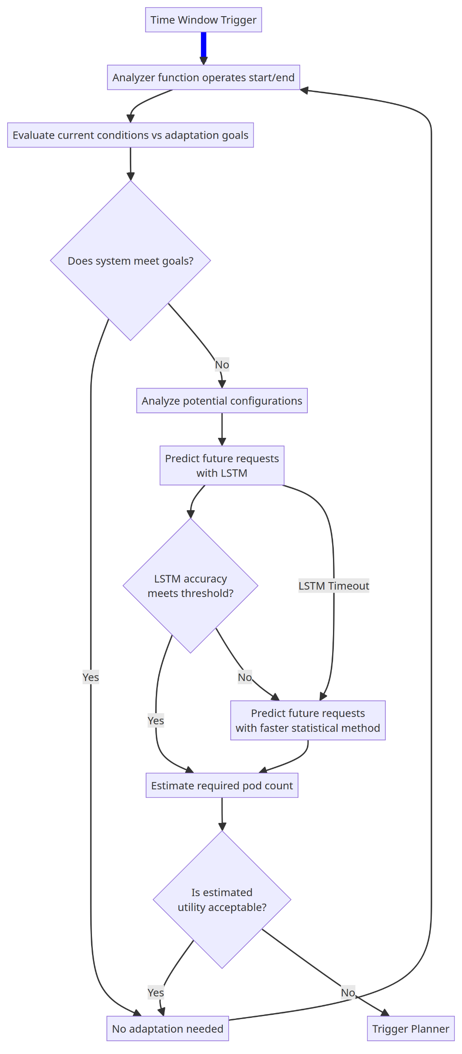
SOLUTION
DL Model
Long-Short Time Memory
Statistical Method
Exponentially Weighted Moving Average
More accurate: ~ 80%
Slow: >10s
Faster: < 100ms
No Long-term memory
Cannot predict expansion
❗️
Loss meets threshold
Training Timeout
Model-switching between Different Approaches
LSTM
EWMA
…
Model
Switching
Module
Appropriate
Predictor

Slide 9
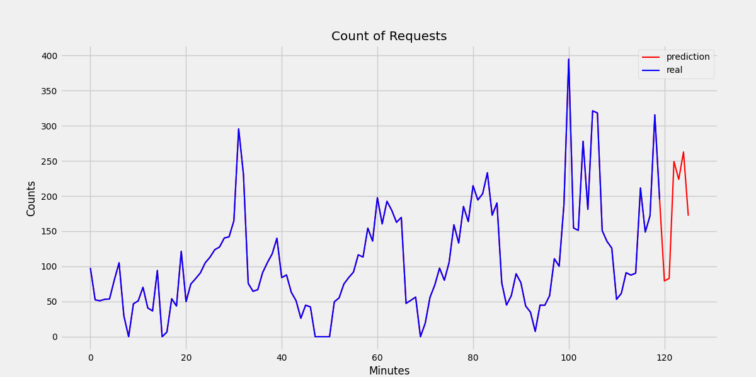
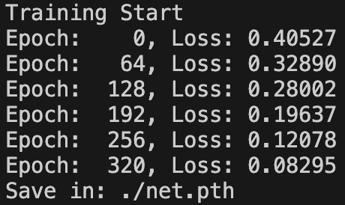
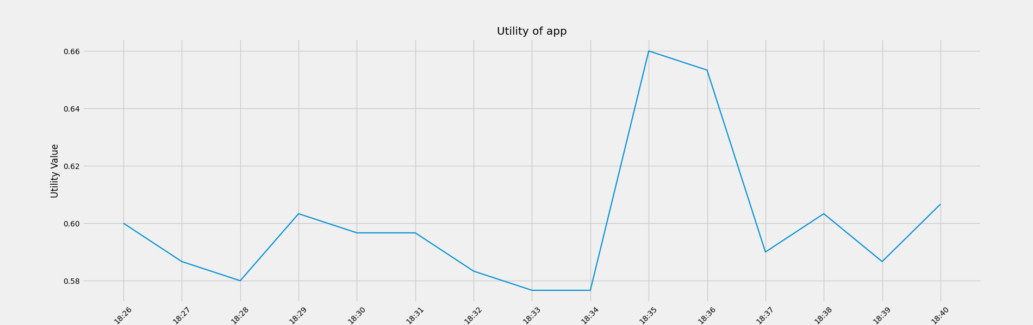
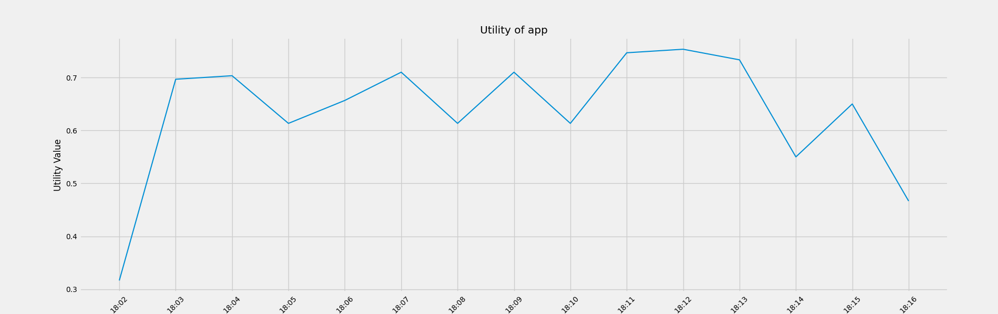
RESULT
Real-Time Prediction for Incoming Requests Using LSTM
Utility Value w/o Adaptation
Utility Value with Self-adaptation
Avg.: ~0.6
Avg.: ~0.7
Average utility after adaption is a little bit of higher than non-adaption system (0.6 to 0.7)

Slide 10
CONCLUSION
The proposed transformation of the ‘Food Lover’ web application into the self-adaptive SAFD system, with its three-layer architecture and predictor switching (LSTM & EWMA) in run-time, contributes to address critical issues of load expansion and extended wait times during peak hours.

Slide 11
Thanks for Listening
Guanjie Wang Lucian Zhao
Department of Elect. & Comp. Eng.

